Slide 1
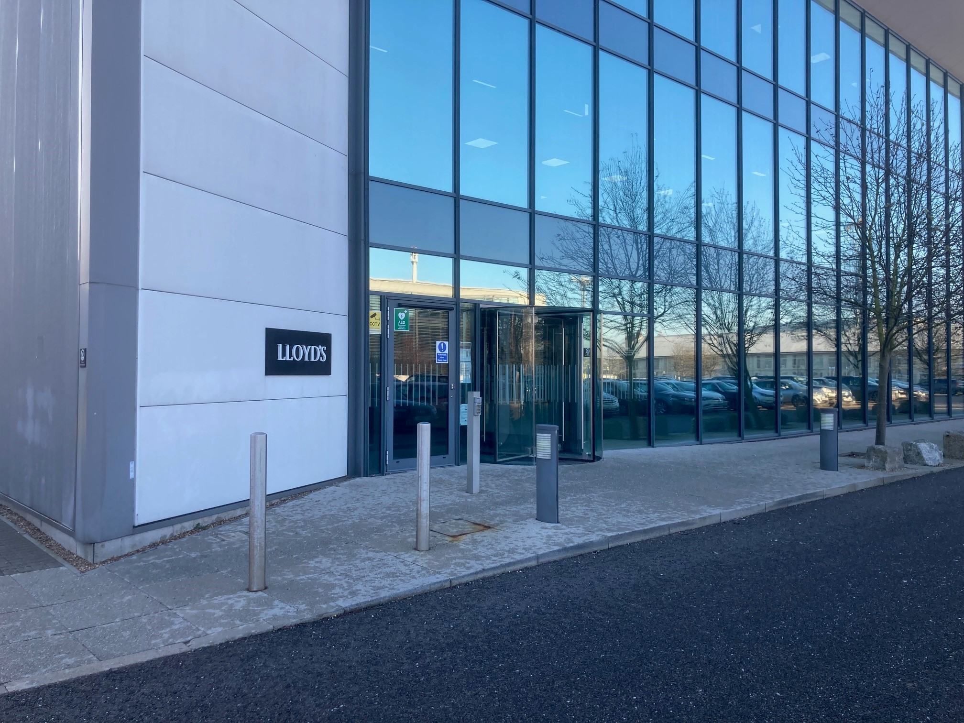
Lloyd’s Chatham Office Accessibility and Inclusion Statement
May 2023

Slide 2
Contents Pages 3-4: Building Introduction
Pages 5-8: Accessibility
Mobility Features
Visual Impairments
Hearing Impairments
Toilets & Accessible toilets
Page 9: Getting here
By bike
By bus, taxi, or car
Mainline stations
Pages 10-12: Additional information
Entrance & Reception
Catering Services
Other facilities
Personal Emergency Evacuation Plan
Welcome to Lloyd’s

Slide 3
We are here to help
Our facilities
The building facilities enable anyone, regardless of ability, to move freely within the building. Lloyd’s is committed to treating people fairly by identifying and removing any unnecessary barriers to participation or progression.
Please let our friendly reception team know if there is any support that can be offered during your time at Lloyd’s (such as access, assistance, alternative formats or disabled parking).
Our purpose
Sharing risk to create a braver world. Together for a braver future.
As we work with customers, partners, and communities around the world, we strive to build a more resilient, sustainable, and inclusive future. A braver future requires all of us to build it. Because no matter our race, ethnicity, ability, sexuality, religion or background, we’re better together. To find more about our purpose, click here.

Slide 4
Lloyd’s Fidentia House
The Lloyd’s Fidentia House Office in Chatham is located in Walter Burke Way, Chatham Maritime, Chatham, Kent, ME4 4RN. Lloyd’s acquired Fidentia House in December 2006 and is occupied by Member Services, Group Finance and Human Resources. The building is comprised of 25,000 square feet with facilities located on ground, first and second floors. A series of photovoltaic solar panels are located on the roof.
Fidentia House is located adjacent to Chatham Historic Dockyard and the Outlet Centre.
Fidentia House has fully adaptable meeting rooms, 2 internal lifts, and offers first-class catering services and state-of-the-art technology facilities. It is served by the mainline station along with excellent bus and taxi services.

Slide 5
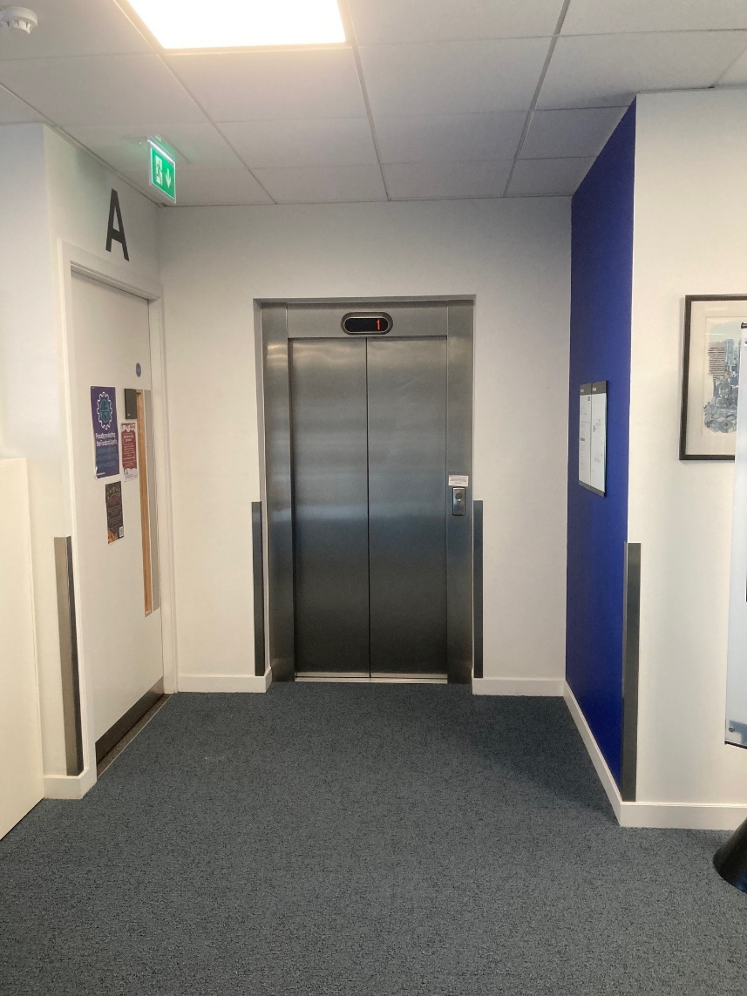
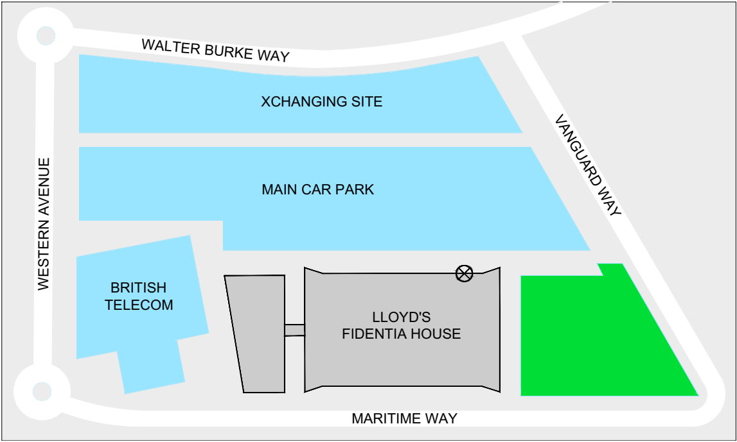
Accessibility
Mobility Features
Collect your building pass and access pass at our main reception. You will now be able to use the internal lifts. Questions? A member of our security team will show you to the nearest lift. All corridors are wide enough for unrestricted access throughout the building.
Our Lifts
There are 2 internal lifts in the building, all wide enough for wheelchair use.

Slide 6
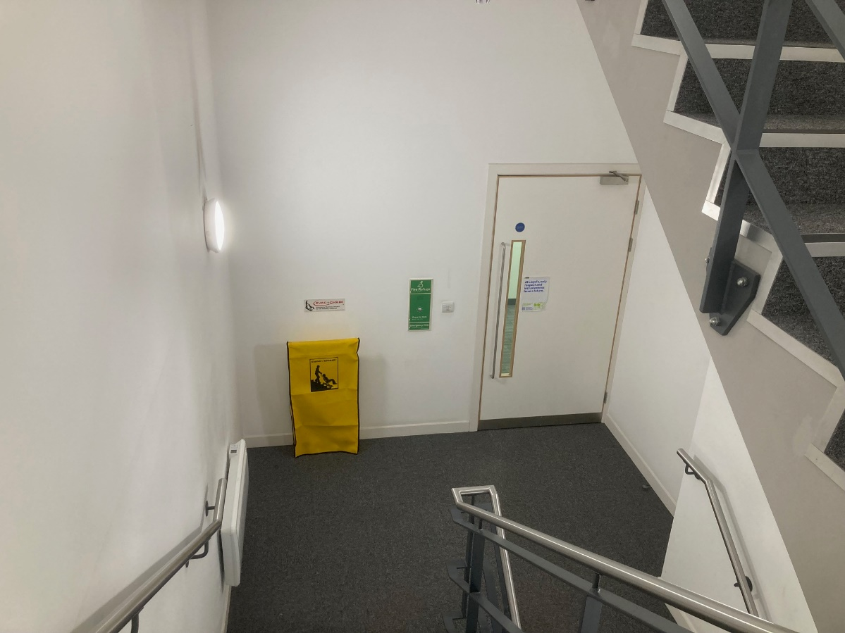
Accessibility
Visual Impairments
You will find our lift control buttons are tactile. All our lifts have a telephone with direct communication to our security control room. Use this in the event of an emergency! Do we allow assistance animals? Yes! .

Slide 7
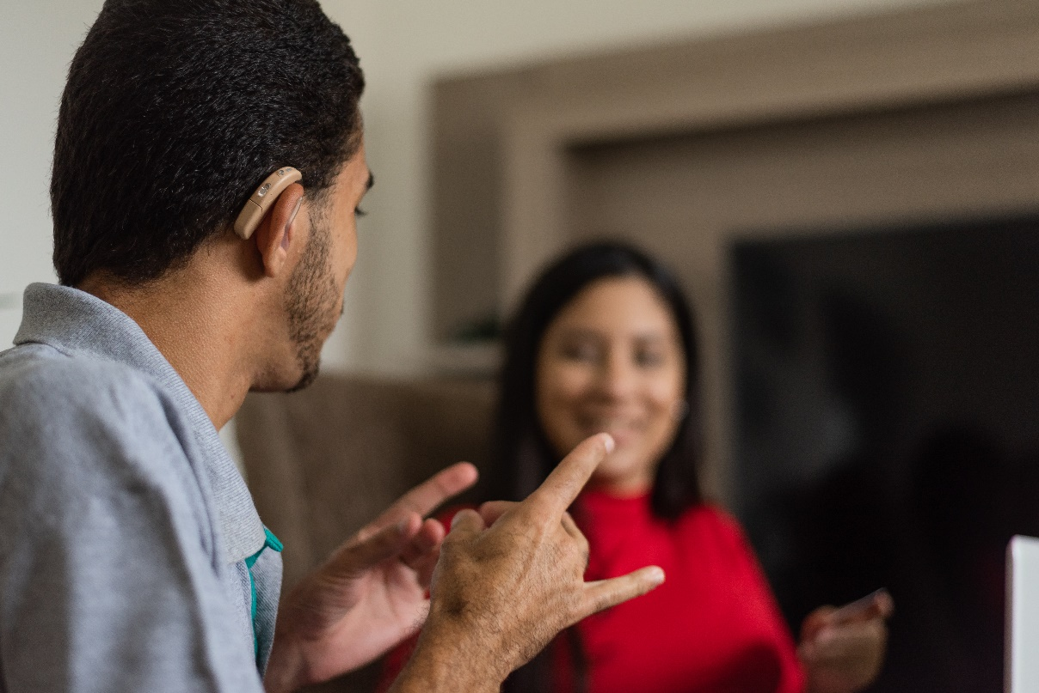
Accessibility
Hearing Impairments
We want to ensure your safety as well as comfort when welcoming you to our building. For those with hearing impairments we provide a hearing loop at Reception. Just ask! What is an induction loop? The induction loop is an assistive listening system that provides access to facilities for those with a hearing impairment. It takes a sound source and transfers it directly to a hearing aid without background noise, interference or acoustic distortion. For your safety there are beacons installed in each of the lift lobbies. They illuminate when the fire alarm is activated.

Slide 8
Accessibility
Toilets & Accessible toilets
There is 1 accessible toilet within Fidentia House. You can find it on: Ground Floor (within the main toilets, adjacent to the restaurant). The toilet has an emergency alarm cord and is fully equipped for wheelchair use. A shower and baby changing facilities are also available here.

Slide 9
Getting here
Mainline station
The nearest mainline is: Chatham: 30-minute walk. This line is served by Southeastern Trains. London Terminals: Victoria, Charring Cross, Waterloo East.
By bus, taxi, or car
Bus numbers 2 and 100 are frequent bus routes from Chatham railway station to Chatham Maritime. A Taxi service is available from Chatham railway station to Lloyd’s Fidentia House. There is a car park immediately adjacent to the main entrance. This has spaces for both visitor parking and disabled parking. It is advisable to contact Fidentia House Reception to reserve a parking space.
By bike
Corporation staff and building tenants can use the cycle racks located to the west side of the building. Need help? E-mail Fidentia House Reception

Slide 10
Entrance & Reception
If required, there is an easily accessible assistance intercom at the front entrance by Reception. This provides communication to our reception and a member of the team will be happy to help with any issues.
The reception is staffed by the security team, who ensure the safety and security of everyone in the building.
For all access pass requests please visit our website.

Slide 11
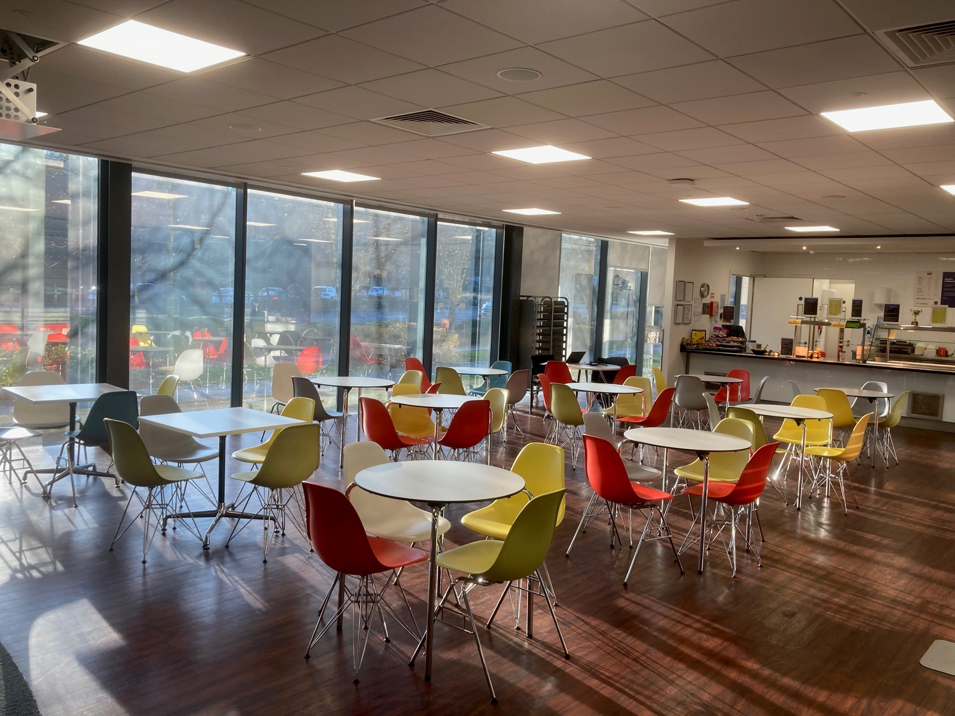
Catering
The restaurant is located on the ground floor and is accessed through reception or from Stairwell B. It can cater for a wide range of allergies, dietary requirements and specific requests. The menus include vegan and vegetarian dishes. For menus and opening times please visit our website. Tea Points and Breakout Areas can be found on the first and second floors.

Slide 12
Further information
Additional Information
The building address is: Lloyd’s Fidentia House Walter Burke Way Chatham Maritime Chatham Kent, ME4 4RN Tel: +44(0)1634 392 2377 E-mail: Fidentia House Reception The general opening hours are 7.00 am to 6.00 pm, Monday to Friday. In the event of an emergency the Security Control Room should be contacted on 0207 327 2222 (ext: 2222). For other useful phone numbers please visit our website. All staff at Lloyd’s of London have regular and refresher disability, equality and diversity training and we are conscious of respecting everyone’s needs and will do everything we can to successfully meet those needs. We have qualified first aiders onsite and dedicated fire marshals. A managed fire evacuation is carried out on an annual basis.
Facilities
Rest Room – This is located on the Ground Floor within the reception area. The room can be used by any person in the building who is feeling unwell and requires a rest period. Please let either a staff member or a security officer know prior to using the room so that safety checks can be made on your wellbeing at periodic intervals. Additional information for parents Mothering Room Mothers who are breast feeding and are expressing milk can use the Rest Room. It is equipped with a bed, chair, table, and washing facilities. Fridges are available on the first and second floors where bottles can be kept; it is advisable that all bottles are secured and labeled. A baby changing cot is available in the accessible toilet.
Personal Emergency Evacuation Plan (PEEP)
If you work at Lloyd’s and are unable to make your way out of the building unaccompanied during a fire evacuation (either due to a permanent or temporary disability), please complete a PEEP (Personal Emergency Evacuation Plan). EVAC Chairs are installed at each landing stage and trained staff are on-site. If you are visiting and require assistance in leaving the building in the event of the fire alarm sounding, please complete a PEEP (Personal Emergency Evacuation Plan) and notify reception when you arrive. Corporation staff only (MyLloyd’s): Complete your Clear Talents profiles and share any concerns you have relating to reasonable adjustments!

