Slide 1
The Control Framework:
Delegated Authorities Operations Committee’s (DAOC) questionnaire around brokers as intermediaries

Slide 2
Welcome
Introduction by Peter Montanaro

Slide 3
Stephen Yates
Lloyd's International Regulatory Affairs

Slide 4
Lloyd’s Prudential challenges
Issues
“Level playing field”
Issues
IFRS / Local GAAP
Issues
Assurance
Issues
“Performance data”
Issues
Country specific solvency / ORSA
More data
More reporting
More local assets

Slide 5
Where does the Control Framework fit into this?
Regulators seeking ever more information
Lloyd’s data increasingly subject to audit or other assurance work
Best defence is good underlying data, and systems and controls around data that inspire confidence and a trust relationship with regulators

Slide 6
One stop Co-ordination on our favourite topic
Tax and Regulatory requirements Charles Rowley – XL-Catlin Chair of Delegated Authority Operations Committee - DAOC

Slide 7
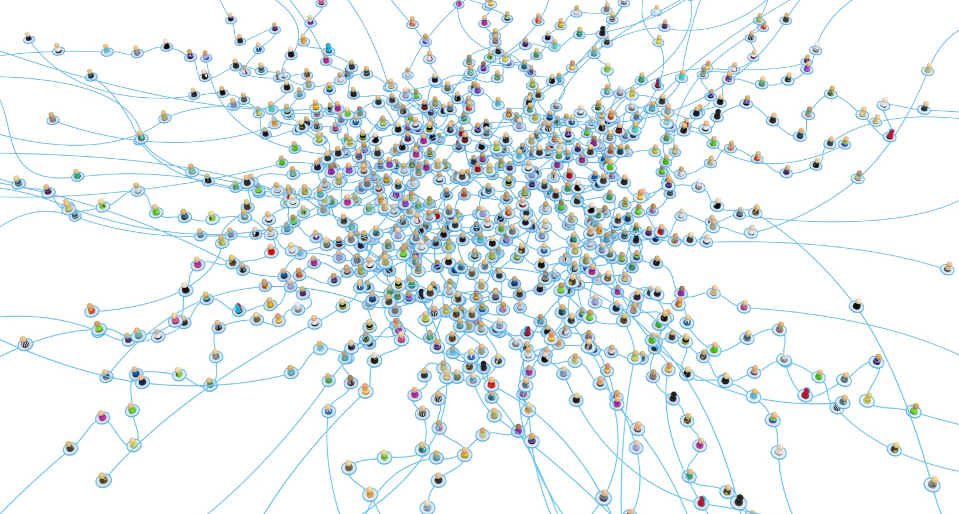
Simple sharing via Lloyd's
From this
Lloyd’s
DAT
to this

Slide 8
Why
Board sign off by Managing Agents to confirm:
“sufficient assurance on accuracy, quality and completeness of regulatory and tax information captured by coverholder(s) has been gained.”
By 31st December 2015.

Slide 9
Why? Regulator request
Italian tax
Forbes “A 160 Bn tax enforcement issue!”
Requested details of transaction level data on Freedom of Services tax business from Lloyd’s
Data required - Fiscal Tax Code, IVA number, Name and Address for each transaction under each bordereaux
Lloyds request bulletin – February 2015 by end-February 2015.
Tax rates are 21.25%, 12.5%, 10%, 7.5%, 4.38%, 2.5% and 0.05% depending upon class!
Way to simplify life this in the future? Use the standard bordereaux format.

Slide 10
What
Two stage process –
Coverholder audit data check - ongoing
Focus is on risk location and insured domicile
Higher risk
Risks written in non-domestic Territories.
Certain transit classes
“Worldwide” binding authorities
Understand broker changes to original data (if any?)
Liaison with LIIBA

Slide 11
Understanding Broker changes?
Brokers may change data - MA’s need to be understand what is altered from original source.
What changes if any do Brokers make to the bordereaux submitted by Coverholders? Re-formatting only / Validation only / New Data / Data Cleansing / New Data, Data Validation and Cleansing.
Questionnaire and spreadsheet will provide detail.
To make it easier for all the DAOC asked Lloyd’s to facilitate centrally.
Brokers with only one central process for all bordereaux may provide a single response detailing their process. No need to complete the spreadsheet. Details of technology used would be useful.
Where different approaches are used on different UMR’s these are to be detailed in the spreadsheet.

Slide 12
Action
Timeline - Lloyd’s distribute spreadsheets 22/6/15.
Sign-off by an officer of the broking company.
Returns back to Lloyd’s (not Managing Agents) by 24/7/15.
Lloyd’s will filter by UMR level and send to relevant Managing Agents.
Lloyds to send to Managing Agents 31/7/15.
Brokers who do not supply completed returns will be followed up individually by Managing Agents resulting in inconvenience for all.

Slide 13
Simple sharing via Lloyd's
From this
Simple
Centralised
Co-ordinated
Lloyd’s
DAT
to this

Slide 14
Any questions?

