Slide 1
A warm Welcome to the September market Breakfast Group
Control Framework

Slide 2
Breakfast Group agenda
Control Framework
9:00 Arrival, breakfast & networking All
9:15 Welcome Ali Dove
9:20 Control Framework project and broker Jaana Rouvari &
update Martin Baker
9:35 Lloyd’s Direct Reporting update Sharmi Bakrania
& coverholder pilot
9:55 ACORD – The foundation that delivers Trevor Maddison
global change
10:15 Q&A All
10:30 Close

Slide 3
Control framework Phase II
Project Update
Jaana rouvari
Control Framework

Slide 4
Project Update
Control Framework
Most managing agents have agreed how they will approach broker communications
Majority of the work across the market is still focussed on identifying controls and evidencing the remediation plan
Key topics at the moment are how to collate and share the right level of assurance
More than half of all managing agents are still signing off by end of December 2014

Slide 5
Martin Baker
Control Framework
Stakeholder Manager – Lloyd’s Brokers

Slide 6
A brief history of Me………
Control Framework
20 Years in the insurance industry within the broking sector
A diversity of roles………
A variety of classes of business………
………and now the Corporation of Lloyd’s

Slide 7
We have a cunning plan!!
Control Framework

Slide 8
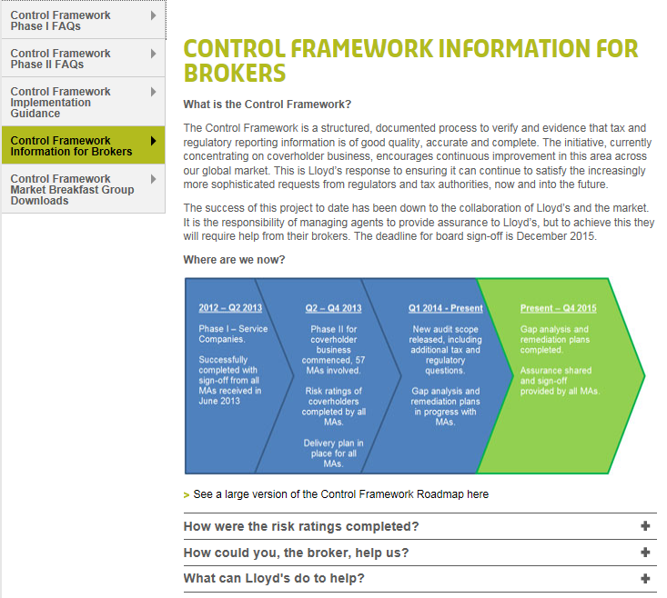
Control Framework
How we plan to communicate
To access the above click here

Slide 9
Current Topics
Control Framework
The broker as the intermediary
Managing Agents:
Are you comfortable with the role your brokers play as an intermediary?
Brokers:
Can you provide evidence to your MA’s with regards what you do in your role as the intermediary?
Moving forward:
Lloyd’s is currently working with the Delegated Authorities Operations Committee (DAOC) putting together a questionnaire.

Slide 10
Positive Market Feedback
Control Framework
Sharing coverholder ratings
Meetings between central contacts

Slide 11
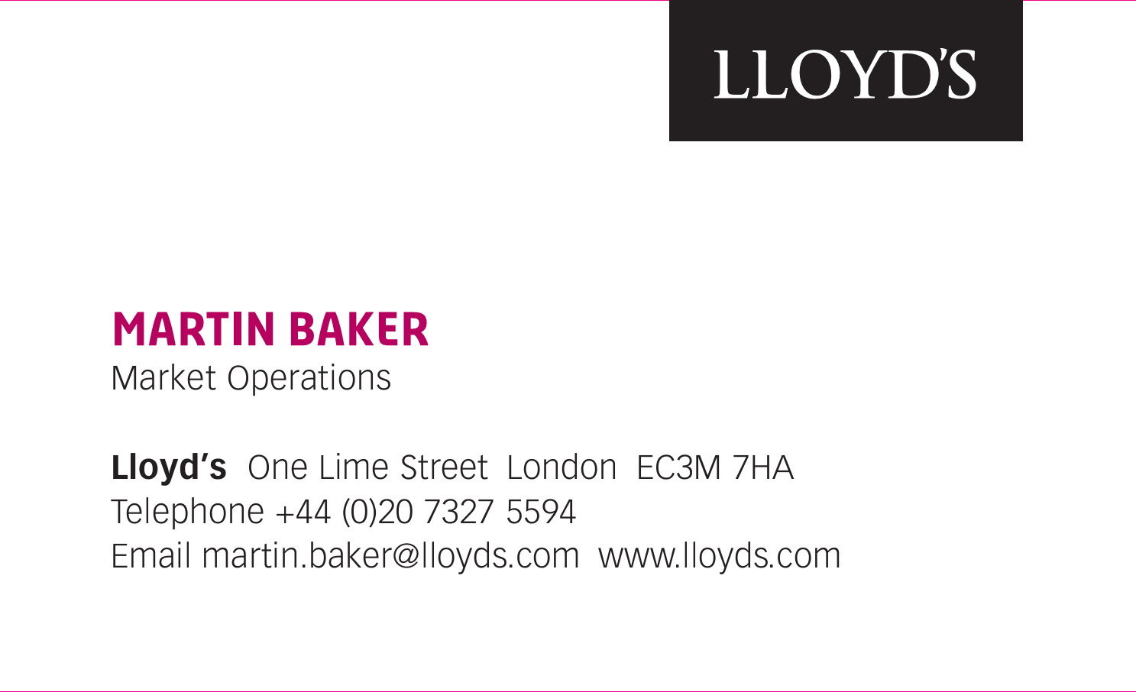
Contact Details
Control Framework

Slide 12
Control Framework in 2015
Control Framework
Handing over to Lloyd’s Delegated Authorities team
Martin will continue to support broker engagement
Next breakfast group meeting in December 2014
Analysis on Phase III

Slide 13
Control Framework
ANY QUESTIONS?

Slide 14
Lloyd’s Direct Reporting
Control Framework Breakfast Group
9 September 2014 Sharmi Bakrania

Slide 15
What is LDR?
A process that enables Managing Agents to report regulatory & tax information directly to Lloyd’s
Data is at a transactional level as opposed to reporting information being derived from the bureau accounting process
Breaks the link between accounting and reporting (on cash)

Slide 16
Scope
100% service company business
‘Separate’ subscription business
Non-cash

Slide 17
Current status
5 managing agents are live on the system
4 are currently working towards a 1/1/15 go-live
10 more are planning to join during 2015

Slide 18
Coverholder pilot
6-month pilot with one managing agent
100% non-cash business
Planned to start in October
Further approval required on completion
Control framework sign off is a prerequisite

Slide 19
Enhancement project
Sub-delegation of business from Singapore service companies to coverholders
Technical changes to improve system performance
Consolidation of LDR, Xchanging and Non-XIS data

Slide 20
Other initiatives
Lloyd’s China
Working with NIIT to develop a solution for integrating the LDR return file into Subscribe

Slide 21
Project Team
Executive Sponsor – Shirine Khoury-Haq
Programme Manager – Ali Dove
Project Manager – Sharmi Bakrania
Technical Manager – Kevin Blake
Senior Business Analyst – Jessica Owen
Business Analyst – Oliver Furner
Web: www.lloyds.com/directreporting
Email: direct.reporting@lloyds.com
Phone: 020 7327 6696

Slide 22
Any questions?

Slide 23
“The foundation that delivers global change”
Trevor Maddison
Director, ACORD Membership

Slide 24
ACORD mission and vision
Mission
ACORD (Association for Cooperative Operations Research and Development) is a global, nonprofit organization. We facilitate the development and use of standards for the Insurance, Reinsurance and other related financial services.
Vision
ACORD envisions an insurance industry that embraces a global and enterprise view of information, in which relevant business solutions all include or provide for ACORD Standards. ACORD wants all trading partners to be able to easily exchange information.
ACORD's vision includes implementation of best practices for enterprise architecture, including systems made up of interchangeable components based on ACORD Standards that provide a 360-degree view of people, organizations, and risks. Products and services built upon these components will be highly configurable and will enable a wide range of consistent transactions and processes across the entire insurance value chain.

Slide 25
ACORD - Who are we?
ACORD (Association for Cooperative Operations Research & Development)
We started in 1970
Headquartered in New York with a London office
ACORD we are a small organisation of 60 people but with a big impact
Working closely with our business partners (Brokers, Carriers, Solution providers)
Build and deliver data standards to the global insurance stage
Business split by domains – Global Reinsurance and Large commercial (GRLC), Life, P&C,
We are not for profit our revenue is membership
We are looking to grow our membership footprint

Slide 26
Who are our members
80% of the Top 10 and 60% of the largest 25 P&C Carriers
60% of the Top 10 and 68% of the largest 25 L&A Carriers
60% of the Top 10 and 36% of the largest 25 Global Reinsurance Carriers
60% of the Top 10 Brokers globally

Slide 27
Scope of ACORD standards
GRLC scope
Non-life Reinsurance
Large Commercial Insurance
Global
P&C scope
Personal Insurance
Commercial Insurance
USA / Canada
L&A scope
Life Insurance
Annuities
Life Reinsurance
USA / South Africa
AML scope
All Insurance and Reinsurance
Annuities
South Africa / Australia
All supported by ACORD framework
A streamlined business model for all standards creation that is flexible enough to cross lines of business and geographic borders – the marketplace is more diverse and global
The ACORD framework is a series of interrelated models or facets used to define different views of the Insurance industry.
Business Glossary
Capability model
Information model
Data model
Component model

Slide 28
GRLC - Value of membership
Full range of ACORD messages to support the business of Insurance and Reinsurance
Technical resource via documentation
  XML message specs
  Implementation guides
  Industry best practice
  Data Dictionary
  Testing Certification Facility
  Message schemas and validators
ACORD Implementation Services – improve data flow
  Realize the benefits of standards or Framework implementation
  Tools and resources that maximize investment in ACORD standards
  Remove internal barriers to ACORD implementation
Education services
  ACORD Certified Expert (ACE)
ACORD events
Opportunity to be part of ACORD committees
  Working groups
  Steering committee’s
Opportunity to influence development of the message and implementation guides
ACORD awards – acknowledgement of the achievement demonstrated in standards development and implementations
Voting on key issues such as the standards development process
Testing and certification of your message builds

Slide 29
Global Reinsurance and Large Commercial
ACORD’s GRLC data standards have been implemented in five continents and more than forty countries - Global
ACORD also facilitates a network of Implementation communities in different geographies to provide advocacy and support to brokers, insurers and reinsurers
  London
  Europe
  North America
  Bermuda
  Asia – Pacific
  Australasia
The Global footprint is growing
  Russia – 3 year project (from 4 Qtr. 2013)
  India
  South Africa

Slide 30
Global Reinsurance & Larger Commercial (GRLC)
Message types
Placing
Tech account
Claim movement
Premium & Claims Bordereau
Risk bound reporting
Catastrophe Exposure Reporting
Settlement
Acknowledgement
Regulatory reporting
DRI
Where we are
Global
Peer to Peer (B2B)
The Messaging Exchange - Tmel
Placement
Endorsements
Genesis (DCS)
Nettsett
ACORD4ALL
(Central System Refresh Programme) CSR
Future process
Gateways / MMT’s
Internal system to system messaging

Slide 31

Achieving consistent implementation
Image credit: Zurich U.S.

Slide 32
Achieving consistent implementation
Technical standards
Defines the details of how systems talk to each other:-
XML message specifications
XML schema & message templates
ACORD Messaging Service
Document Repository Interface standards (DRI)
Implementer standards
Defines how messages are used and will interact to support the business process:-
Placing Guides
Implementation Guides
AMS & DRI Guides
EBOT
ECOT
Data dictionary
Validators
Community standards
Defines what members of a community agree they will implement:-
Global (Re)insurance Best Practices
Together these create a plug and play system

Slide 33
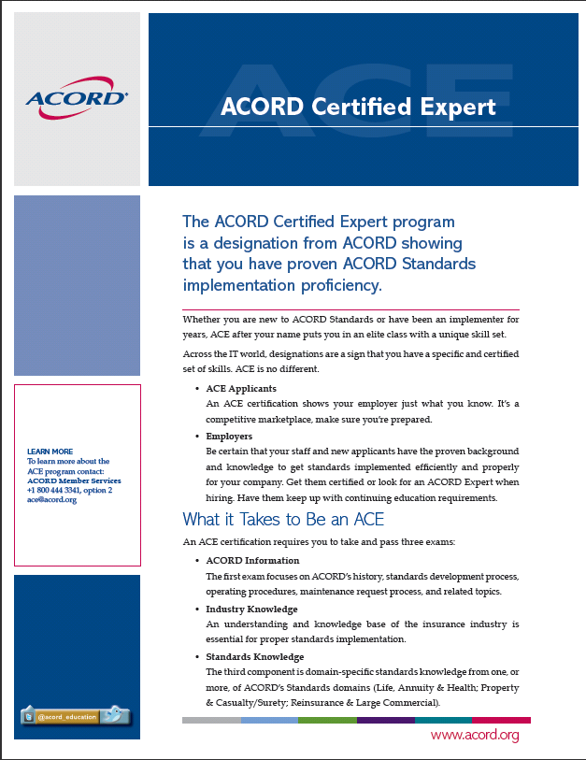
ACE
A Personal designation
Details are available from website – including application form
Training / exam schedule
  You can apply to take any time – but good option is to follow training sessions…
  1: High level
  2: Standard operating procedures
  including Maintenance Requests
  3: Data dictionary (including
  detailed data and XML spec)
  4. : DRI and AMS
  5: Back office standards
  6: Placing
  7: TCF and Validators
See: http://www.acord.org/standards/implementation/ace/Documents/ACEFlyer.pdf

Slide 34
The Binder world
Four market initiatives – moving towards XML
Project Tomorrow
  working with a large Australian cover holder who want to sent XML for risks bound (premium & claims)
  Kiln & Chaucer working with the vendor to define requirements
  First risks bound XML data in test using ACORD AML standards
Binder 360
  Xchanging service to map & cleanse bordereaux
  Can accept any spreadsheet or any other format
Binder Cloud
  Web based binder / bordereau management tool
  Bordereaux loaded from standard spreadsheet or ACORD XML
  Data stored using XML column names
Project Phoenix
  Allows users of the Morning data broking system to export risks bound/premiums/claims as XML or standard spreadsheets
ACORD
  Implementation group

Slide 35
5 years is along time
Let’s give credit to the pace of change – the foundation has been put in place
Approx. 200+ stakeholders within the UK, North America, Bermuda, Asia Pacific and European markets all using standards to increase efficiency
7.3 million DRI messages delivered claims and premium documents to the IMR in 2013
200,000 business messages for placement and Ebot (20,000) going through Tmel for 2013 (total of all ACORD messages types 1 million+)
2.5 million number of messages going peer to peer for the “Ruschlikon Initiative
Impressive stats delivering real value into each organisation

Slide 36
Some thoughts around the impact of change
Are we changing fast enough
The GRLC world is embracing change quickly
Change is driven by the need of the business
Pick your fights – Big Bang does not work, win the ones that matter
Collective leadership across the globe to deliver change (the big decisions)
Collaboration works (is working)
Expanding the distribution channel – efficient distribution is key
What is the driver for change, not always efficiency, what sells, increased revenue through increased business opportunities ticks the senior executive box
A single way to do business
Common process and standards allow technology to be global
Plug and play irrespective of the technology used
Easier to deliver & enforce one single standard

Slide 37

And finally – why it works!
Active community
Plug and play standards
Training & help
Standards Certification

Slide 38
ACORD are on Facebook
www.facebook.com/acordstandards

Slide 39



Slide 40



One Blue Hill Plaza
15th Floor
Pearl River, NY 10965
USA
+1 845 620 1700
NEW YORK
OFFICE
London Underwriting Centre
Suite 1/3
3 Minster Court
Mincing Lane
London EC3R 7DD
United Kingdom
+44 (0)20 7617 6400
LONDON
OFFICE
Wednesday, September 24, 2008

Slide 41
Q & A
Control Framework

Slide 42
Close
Control Framework
Further information on Control Framework – controlframework@lloyds.com
Next Breakfast Meeting – 9th December
www.lloyds.com/controlframework

